Slide 1
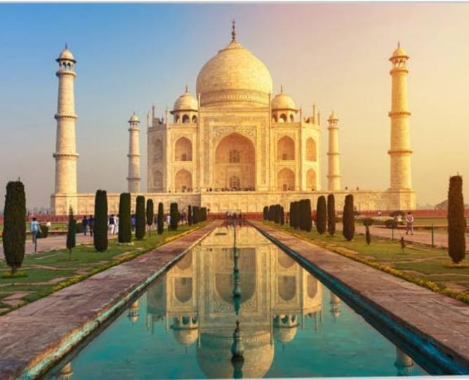
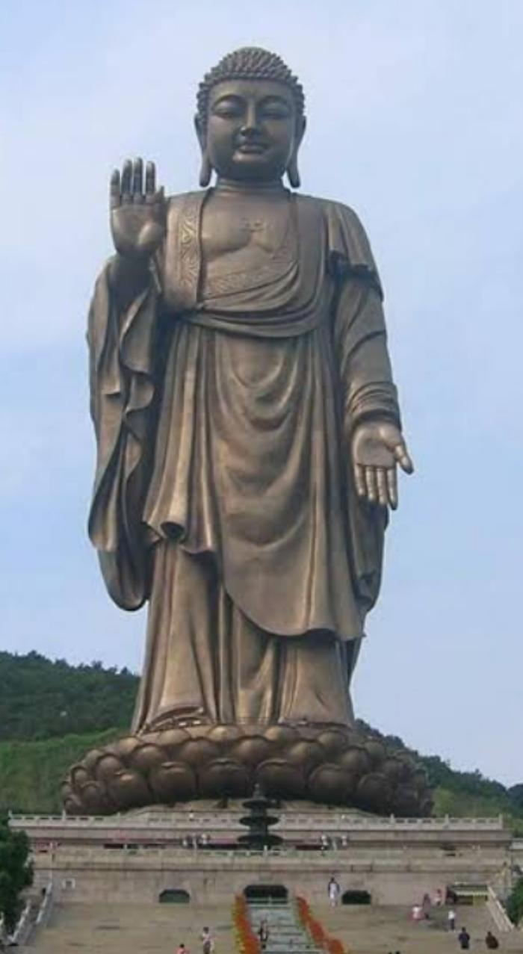
ART AND ARCHITECTURE OF BHARAT
Name-Luv Dogra
Class-9th Wandering minds
Roll no.-11

Slide 2
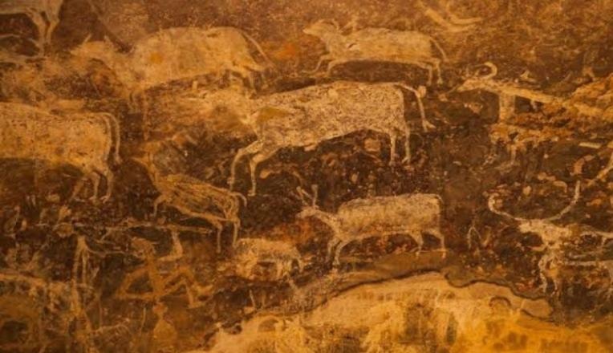
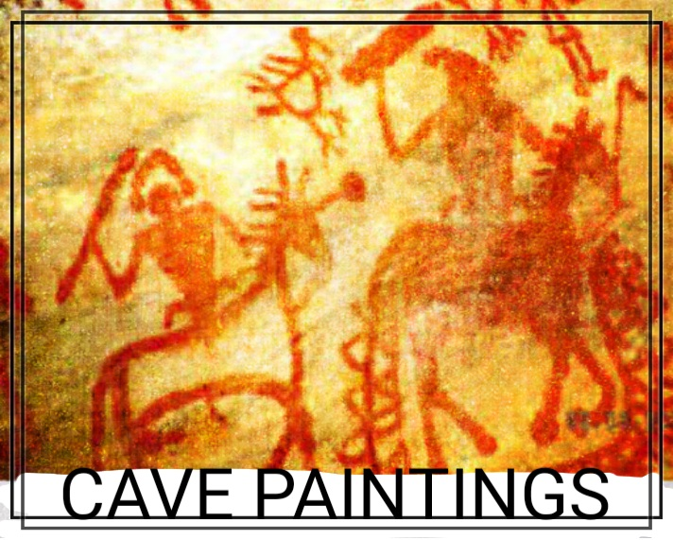
Hk
In Bhimbetka, near Bhopal, in Central India, is
India’s largest and oldest collection of cave
paintings – belonging to the Neolithic Age and
depicting the everyday lives of people.
Numerous references to painting are found in
literature dating back to the Pre-Christian
period. Vatsayana listed painting as one of the
64 kalaa or fine arts in his text Kamasutra. He
went further and elaborated on the 6 principles
of art, or its limbs or shadanga: Rupabheda,
Pramanam, Bhava, LavanyaYoganam, Sadrisyam and Varnikabhanga.
The caves of Ajanta, Bagh, Sittanavasal, Armamalai are all examples of cave paintings. The
themes are mainly drawn from Hindu, Jain and Buddhist religious inference

Slide 3
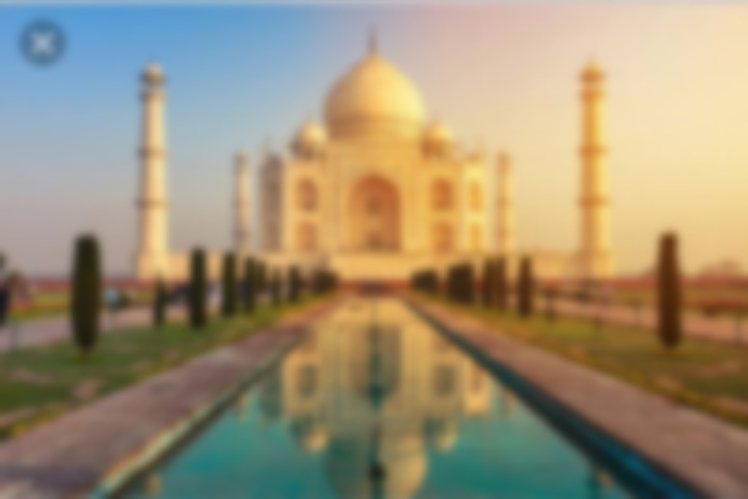

The Taj Mahal incorporates and expands on design traditions of Indo-Islamic and earlier Mughal architecture. Specific inspiration came from successful Timurid and Mughal buildings including the Gur-e Amir (the tomb of Timur, progenitor of the Mughal dynasty, in Samarkand),[14] Humayun’s Tomb which inspired the Charbagh gardens and hasht-behesht (architecture) plan of the site, Itmad-Ud-Daulah’s Tomb (sometimes called the Baby Taj), and Shah Jahan’s own Jama Masjid in Delhi. While earlier Mughal buildings were primarily constructed of red sandstone, Shah Jahan promoted the use of white marble inlaid with semi-precious stones. Buildings under his patronage reached new levels of refinement.

Slide 4
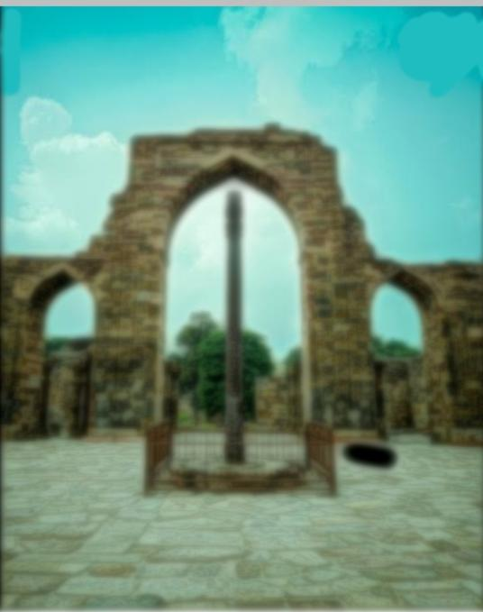
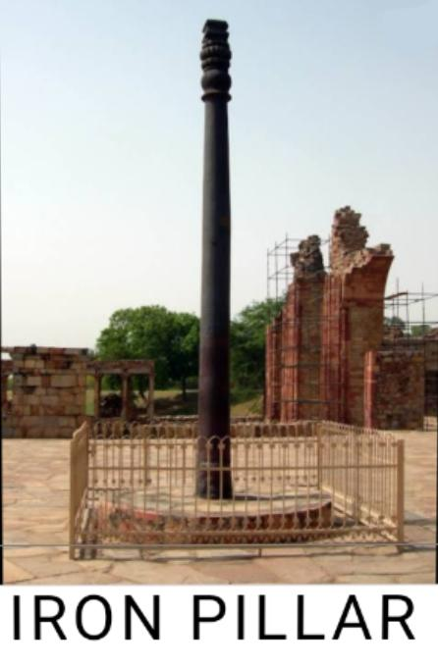
Iron Pillar rust-resistant composition has attracted many metallurgists and archaeologists. It has been known as a testament to ancient Indian Blacksmiths skills. It is highly resistant to corrosion. Resistance to corrosion means there is an even crystalline iron hydrogen phosphate layer. Thus it gets protected from the local climate of Delhi. The height of the Iron Pillar from the bottom of the base to the top of the capital is around 7.21 meters. Out of this, 1.12 meters is underground. Bulb shaped base has a height of 0.71 meters, and the bell pattern capital height is 1.07 meters.

Slide 5
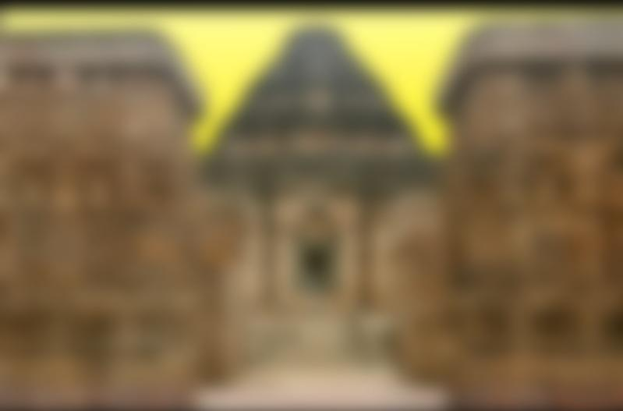
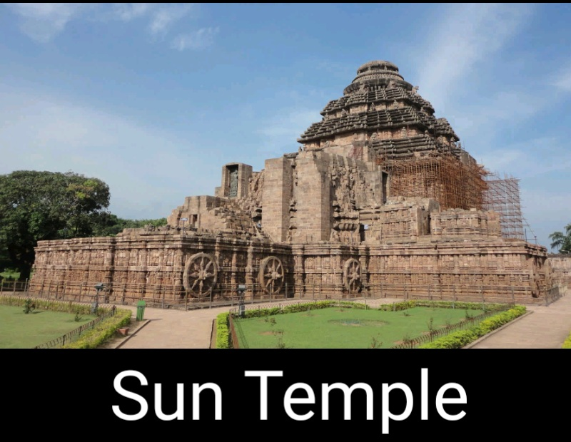
Of all the places to visit in Orissa, there is one place in particular that stands out the most. Whenever you are visiting Orissa, this is the one place that everyone will recommend visiting to experience its grandeur and enormity. It’s the Konark Sun Temple or Konark Surya Mandir. Located in the eponymous village of Konark, 35 km from Puri, it is the remains of a temple that was constructed in the 13th century. If you are visiting Orissa, Konark Sun Temple is a place that you must visit. If you don’t, then your trip to Orissa will stay incomplete. Konark Sun Temple is a UNESCO World Heritage Site and has a cultural relevance even in the 21st century. To explain this better, let’s know about its history, architecture, and why it is so revered

Slide 6
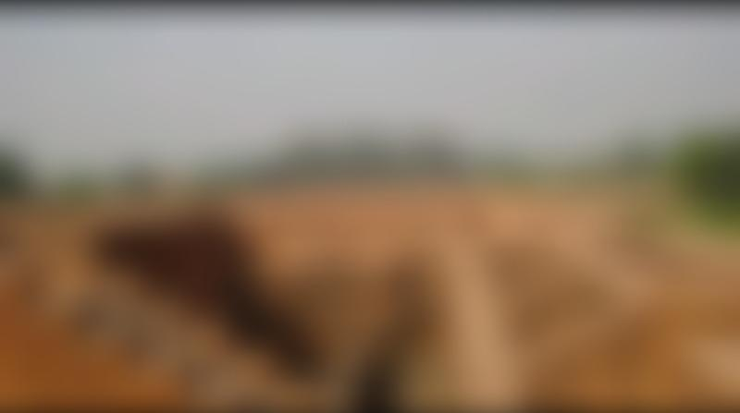
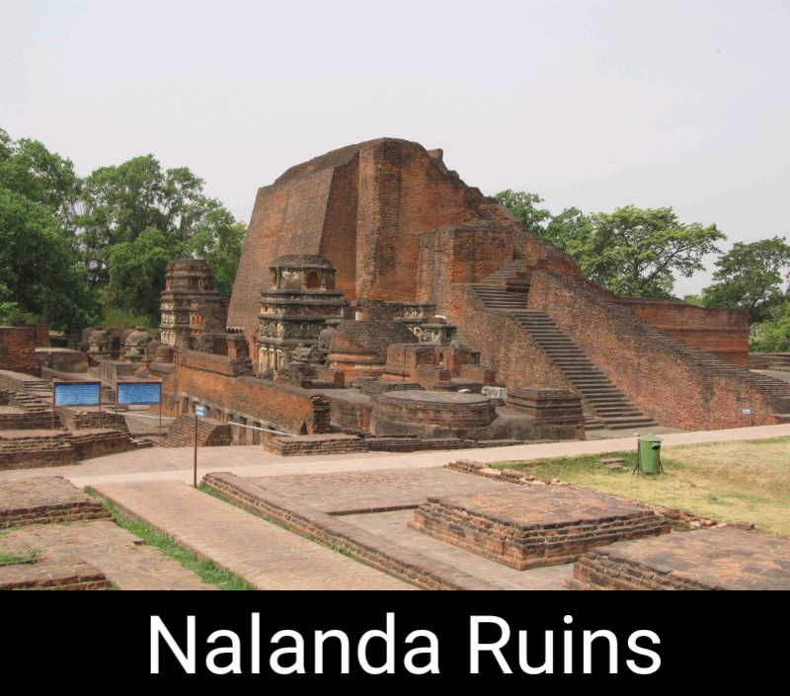
The history of Nalanda in the 1st-millennium BCE is linked to the nearby city of Rajagriha (modern Rajgir) – the capital of Magadha and on the trade routes of ancient India.^{[22]} Early Buddhist texts state that Buddha visited a town near Rajagriha called Nalanda on his preregrinations.^{[10]} He delivered lectures in a nearby mango grove named Pavarika and one of his two chief disciples, Shariputra, was born in the area and later attained nirvana there.^{[23][24]} These Buddhist texts were written down centuries after the death of the Buddha, are not consistent in either the name or the relative location. For example, texts such as the Mahasudassana Jataka states that Nalaka or Nalakagrama is about a yojana (10 miles) from Rajagriha, while texts such as Mahavastu call the place Nalanda-gramaka and place it half a yojana away.^{[19]} A Buddhist text Nikayasamgraha does state that emperor Ashoka established a vihara (monastery) at Nalanda. However, archaeological excavations so far have not yielded any monuments from Ashoka period or from another 600 years after his death.

